Slide 1


Section 5
Network Defenses

Slide 2
Objectives
Explain how to enhance security through network design
Define network address translation and network access control
List the different types of network security devices and explain how they can be used

Slide 3


Slide 4
Security through Network Design
Subnetting
  IP addresses are actually two addresses: one part is a network address and one part is a host address
Subnetting or subnet addressing
  Splits a large block of IP addresses into smaller groups

Slide 5
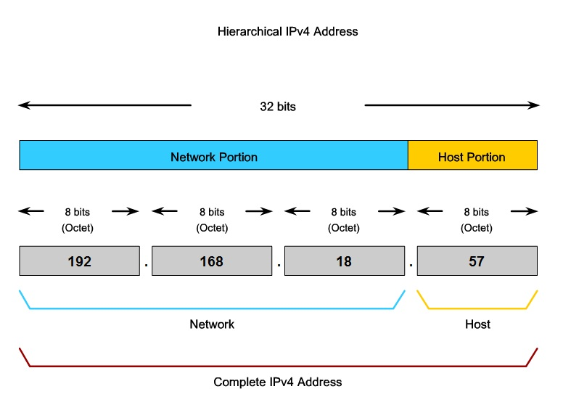
Image from Cisco CCNA Class 1

Slide 6
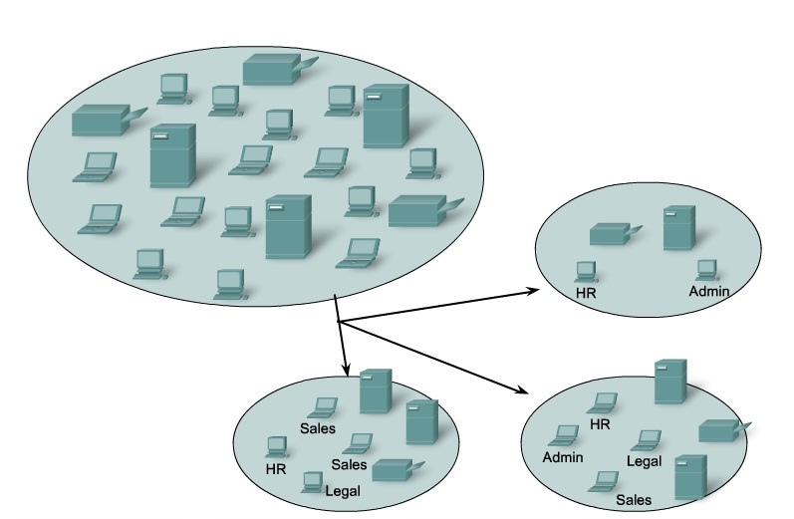
Subnetting at CCSF
Whole College:
147.144.0.0 /16
147.144.0.1 through
147.144.255.254
Eng Dept:
147.144.51.0 /24
147.144.51.1 through
147.144.51.254
CNIT Dept:
147.144.20.0 /24
147.144.20.1 through
147.144.20.254
Image from Cisco CCNA class 1, modified

Slide 7
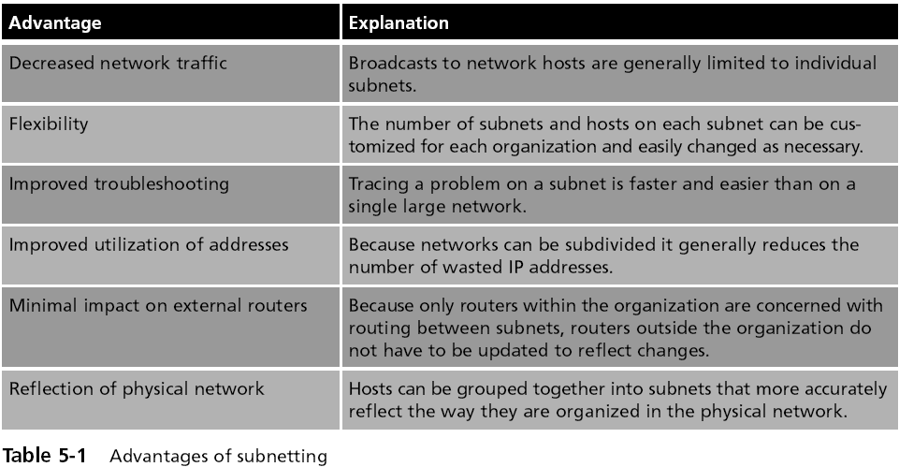
Advantages of Subnetting

Slide 8
Subnets Improve Security
Each subnet can be isolated from the rest of the network
  Traffic between subnets can be monitored and restricted at the routers
Subnets also allow network administrators to hide the internal network layout
  Outsiders only see your public servers, not your private subnets

Slide 9
Virtual Local Area Network (VLAN)
VLANs segment a network with switches, not routers
A VLAN allows scattered users to be logically grouped together even though they may be attached to different switches
Can reduce network traffic and provide a degree of security similar to subnetting:
  VLANs can be isolated so that sensitive data is transmitted only to members of the VLAN

Slide 10
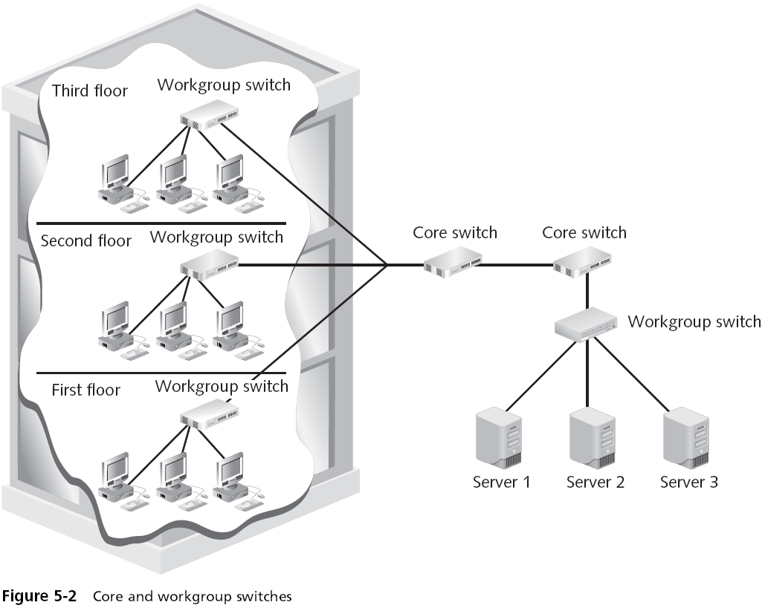

Slide 11
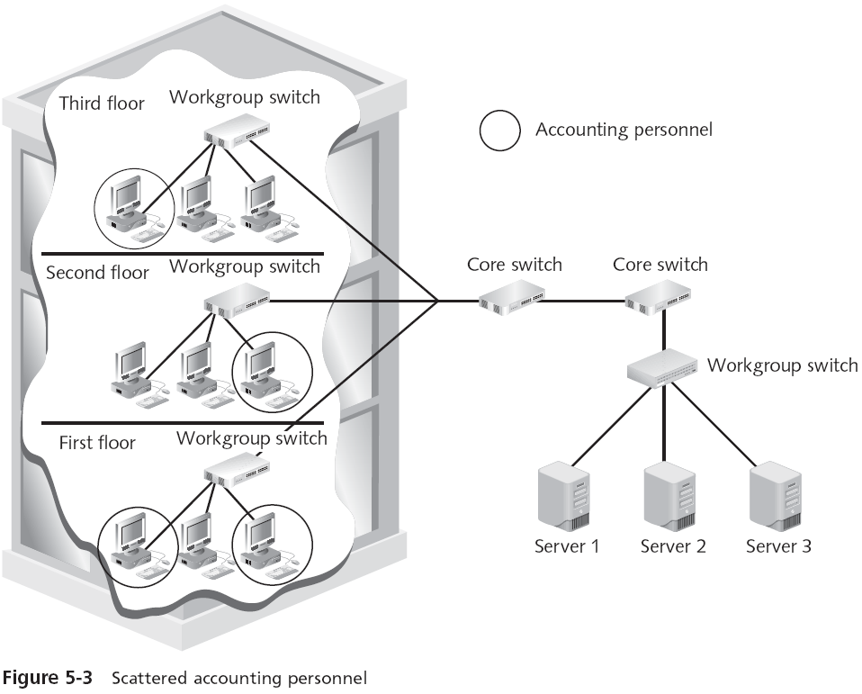
Accounting machines are on their own VLAN

Slide 12
VLAN Security
VLAN communication can take place in two ways
  All devices are connected to the same switch
    Traffic is handled by the switch itself
  Devices are connected to different switches
    A special “tagging” protocol must be used, such as the IEEE 802.1Q-2005
A VLAN is heavily dependent upon the switch for correctly directing packets
  Attackers could take control of the switch itself, if it has a default or weak password
  Specially crafted traffic can also "hop" from one VLAN to another

Slide 13
Network Convergence
Telephone, data, and video all using the same IP network
  Voice over IP, Video over IP
Advantages
  Cost savings
  Management
  Application development
  Infrastructure requirements
  Reduced regulatory requirements
  Increased user productivity

Slide 14
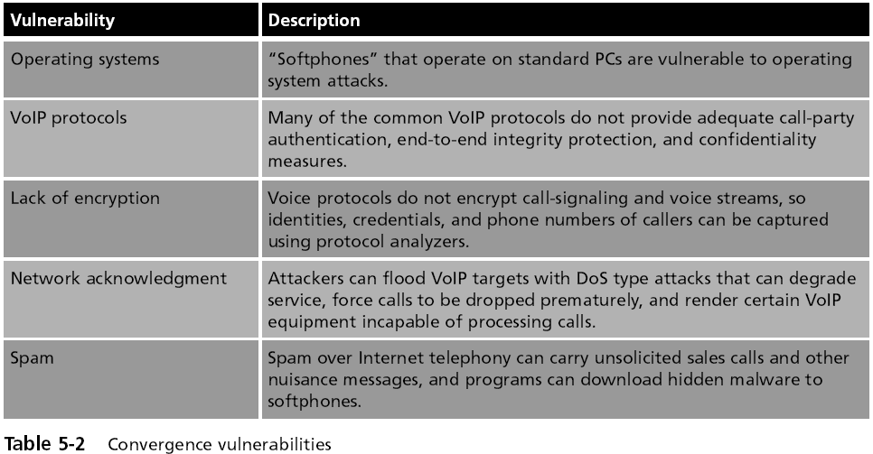
Vulnerabilities in Converged Networks

Slide 15
Demilitarized Zone (DMZ)
A separate network that sits outside the secure network perimeter
Outside users can access the DMZ but cannot enter the secure network

Slide 16
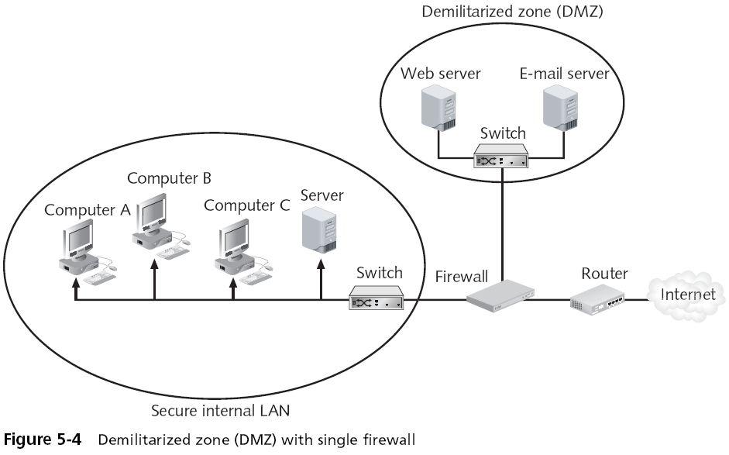
DMZ with One Firewall

Slide 17
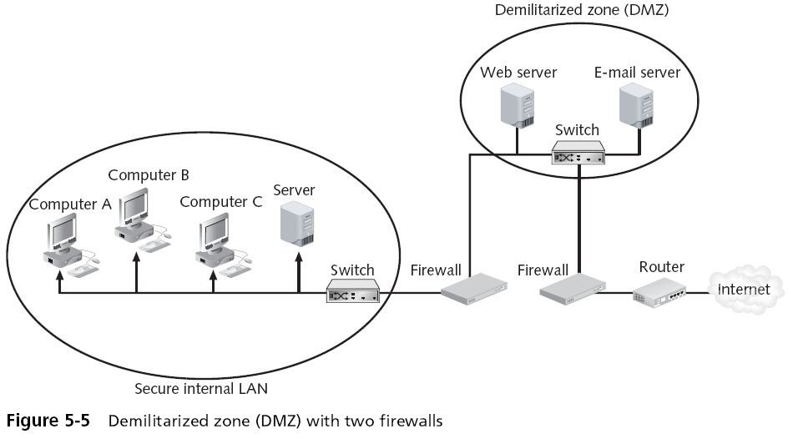
DMZ with Two Firewalls

Slide 18
Network Address Translation (NAT)
  Hides the IP addresses of network devices from attackers
Private addresses
  IP addresses not assigned to any specific user or organization
  Function as regular IP addresses on an internal network
  Non-routable addresses--traffic addressed to private addresses is discarded by Internet routers

Slide 19
Network Address Translation (NAT)
NAT removes the private IP address from the sender’s packet
  And replaces it with an alias IP address
When a packet is returned to NAT, the process is reversed
An attacker who captures the packet on the Internet cannot determine the actual IP address of the sender

Slide 20
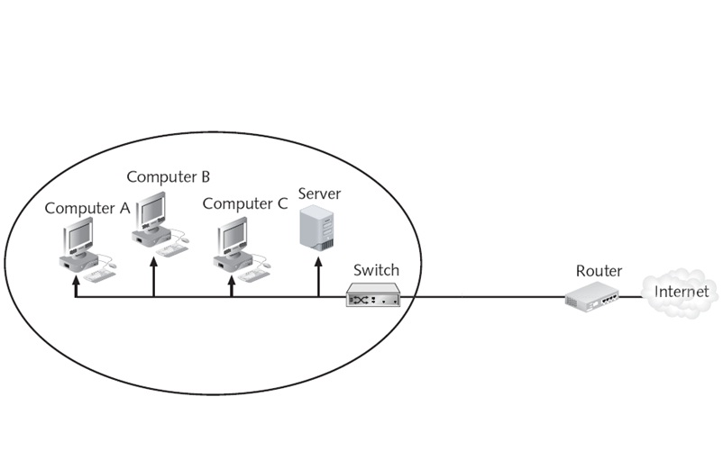





Network Address Translation
(NAT)
Private IP Addresses
Public IP Addresses
Address Translation
192.168.1.101 -> 147.144.1.101
192.168.1.102 -> 147.144.1.102
192.168.1.103 -> 147.144.1.103
192.168.1.151 -> 147.144.1.104

Slide 21
Port Address Translation (PAT)
Normally performed along with NAT
Each packet is given the same IP address but a different TCP port number
Allows many machines to share the same public IP address

Slide 22

NAT with PAT
Web browser: 192.168.1.101 Port 1100
Email: 192.168.1.101 Port 1102
Web browser: 192.168.1.103 Port 1100
Address Translation
192.168.1.101 Port 1100 -> 147.144.1.1 Port 2100
192.168.1.101 Port 1102 -> 147.144.1.1 Port 2101
192.168.1.103 Port 1100 -> 147.144.1.1 Port 2102

Slide 23
Network Access Control (NAC)
Examines a computer before it is allowed to connect to the network
Each computer must meet security policy first, such as
  Windows patches up to date
  Antivirus software
  Antispyware software
  Etc.
Any device that does not meet the policy is only allowed to connect to a “quarantine” network where the security deficiencies are corrected

Slide 24
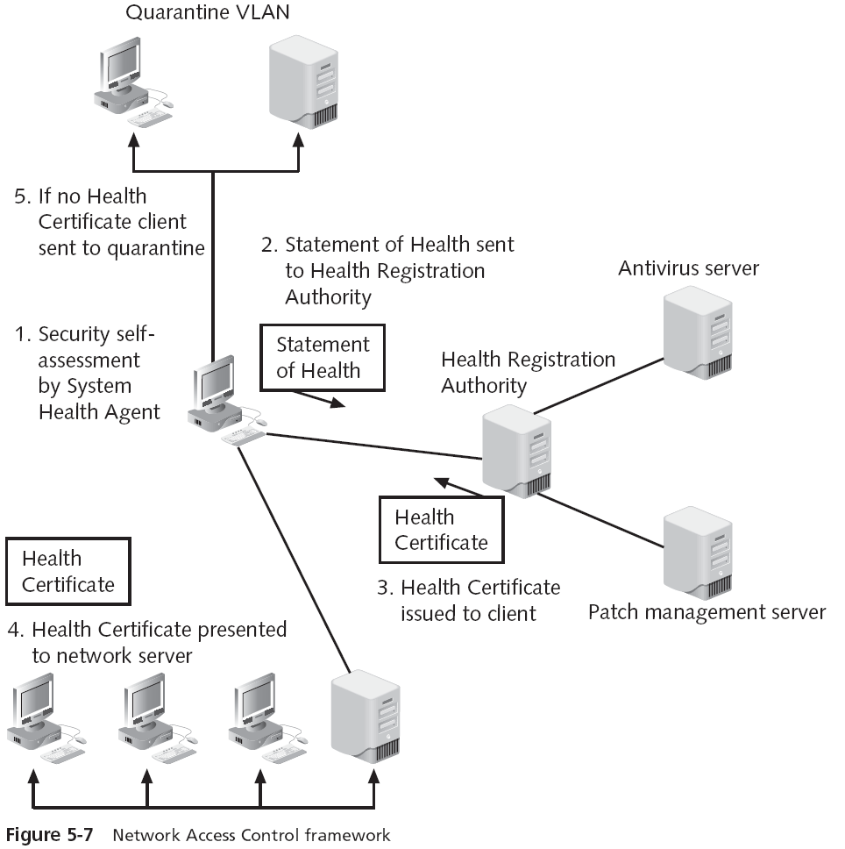

Slide 25


Slide 26
Network Security Devices
Firewalls
Proxy servers
Honeypots
Network intrusion detection systems
Host and network intrusion prevention systems
Protocol analyzers
Internet content filters
Integrated network security hardware

Slide 27
Firewall
  Typically used to filter packets
  Sometimes called a packet filter
  Designed to prevent malicious packets from entering the network
  A firewall can be software-based or hardware-based
Hardware firewalls usually are located outside the network security perimeter
  As the first line of defense

Slide 28
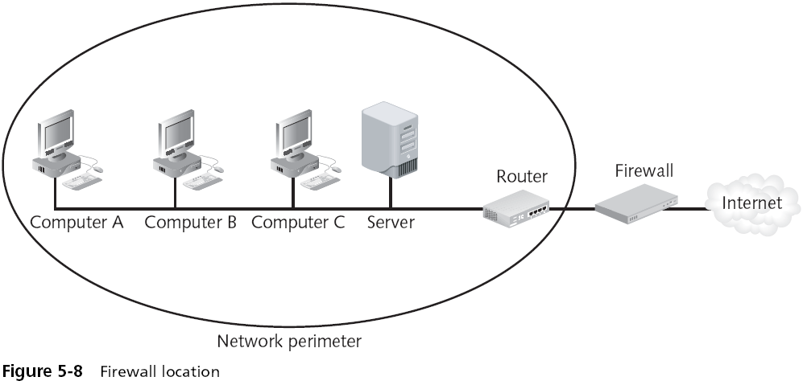
Firewall (continued)

Slide 29
Firewall (continued)
The basis of a firewall is a rule base
  Establishes what action the firewall should take when it receives a packet (allow, block, and prompt)
Stateless packet filtering
  Looks at the incoming packet and permits or denies it based strictly on the rule base
Stateful packet filtering
  Keeps a record of the state of a connection between an internal computer and an external server
  Then makes decisions based on the connection as well as the rule base

Slide 30
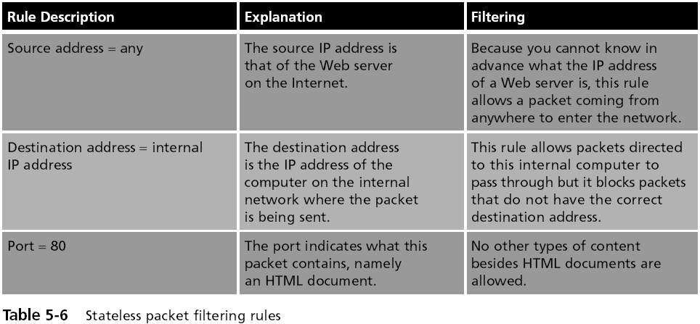
Stateless Firewall Rules

Slide 31
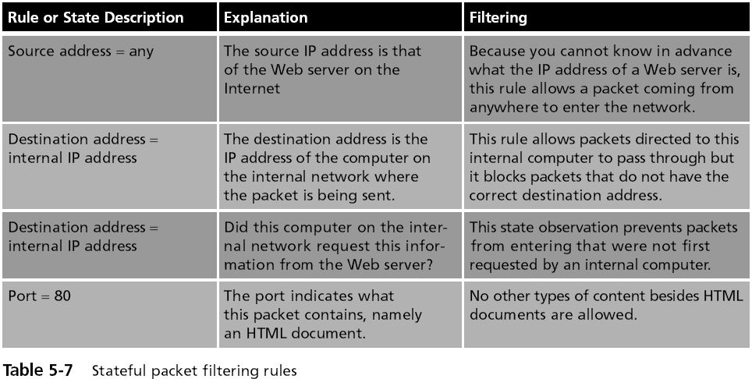
Stateful Firewall Rules
State = Established
Note error in textbook in left column, 3rd row

Slide 32
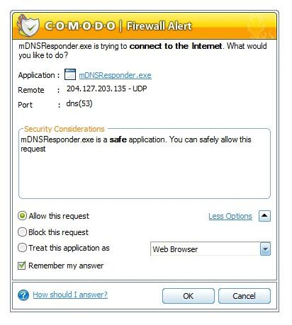
Inbound and Outbound Traffic Filtering
Most personal software firewalls today also filter outbound traffic as well as inbound traffic
Filtering outbound traffic protects users by preventing malware from connecting to other computers and spreading
But it annoys them with these alerts

Slide 33

Proxy Server
I will get yahoo.com and save a copy
I want to see yahoo.com
Internet
Here is my copy of yahoo.com

Slide 34
Proxy Server
Clients never directly connect to the Internet
This saves bandwidth, because one copy of a popular Web page can be used many times
Allows a company to block forbidden Web sites
It also prevents many attacks the same way NAT does
Reverse proxy
  Does not serve clients but instead routes incoming requests to the correct server

Slide 35
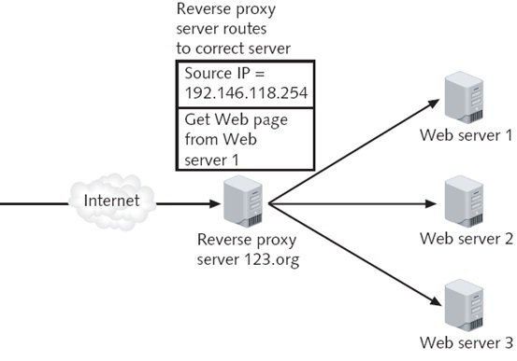
Reverse Proxy
Connect to Web server 1

Slide 36
Honeypot
  Intended to trap or trick attackers
  A computer typically located in a DMZ that is loaded with software and data files that appear to be authentic
    Yet they are actually imitations of real data files
Three primary purposes of a honeypot:
  Deflect attention
  Early warnings of new attacks
  Examine attacker techniques

Slide 37
Network Intrusion Detection Systems (NIDS)
Network intrusion detection system (NIDS)
  Watches for attempts to penetrate a network
NIDS work on the principle of comparing new behavior against normal or acceptable behavior
A NIDS looks for suspicious patterns
Passive intrusion detection just logs the traffic and sends alerts

Slide 38
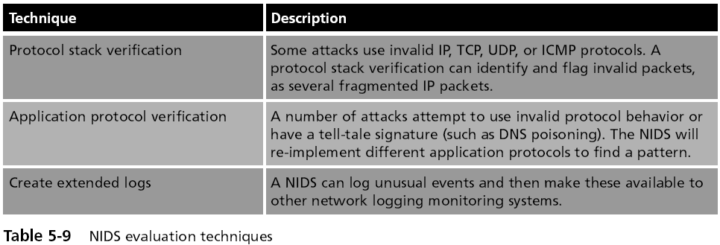
Network Intrusion Detection Systems (NIDS) (continued)

Slide 39
Intrusion Prevention Systems
Finds malicious traffic and deals with it immediately
Also called Active Intrusion Detection
A typical IPS response may be to block all incoming traffic on a specific port

Slide 40
Host Intrusion Prevention Systems (HIPS)
Installed on each system that needs to be protected
Rely on agents installed directly on the system being protected
  Work closely with the operating system, monitoring and intercepting requests in order to prevent attacks

Slide 41
Host Intrusion Prevention Systems (HIPS)
Most HIPS monitor the following desktop functions:
  System calls
  File system access
  System Registry settings
  Host input/output
HIPS are designed to integrate with existing antivirus, anti-spyware, and firewalls
HIPS provide an additional level of security that is proactive instead of reactive

Slide 42
Network Intrusion Prevention Systems (NIPS)
Work to protect the entire network and all devices that are connected to it
By monitoring network traffic NIPS can immediately react to block a malicious attack
NIPS are special-purpose hardware platforms that analyze, detect, and react to security-related events
  Can drop malicious traffic based on their configuration or security policy

Slide 43
Protocol Analyzers
Three ways for detecting a potential intrusion
  Detecting statistical anomalies (unusual traffic)
  Examine network traffic and look for well-known patterns of attack
  Use protocol analyzer technology
Protocol analyzers
  Can fully decode application-layer network protocols
  Parts of the protocol can be analyzed for any suspicious behavior
    Such as an overly long User-Agent field in an HTTP GET request

Slide 44
Internet Content Filters
Internet content filters
  Monitor Internet traffic and block access to preselected Web sites and files
  A requested Web page is only displayed if it complies with the specified filters
Unapproved Web sites can be restricted based on the Uniform Resource Locator (URL) or by matching keywords

Slide 45
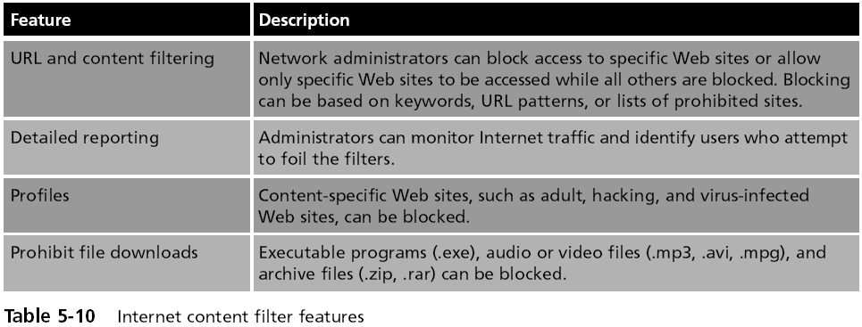
Internet Content Filters (continued)

Slide 46
Integrated Network Security Hardware
Types of hardware security appliances:
  Dedicated security appliances provide a single security service
  Multipurpose security appliances that provide multiple security functions
Integrated network security hardware
  Combines or integrates multipurpose security appliances with a traditional network device such as a switch or router
  Particularly attractive for networks that use IDS

